Slide 1
OHS Act Amendments Preventing Serious and Repeat Violators Spring 2017

Slide 2
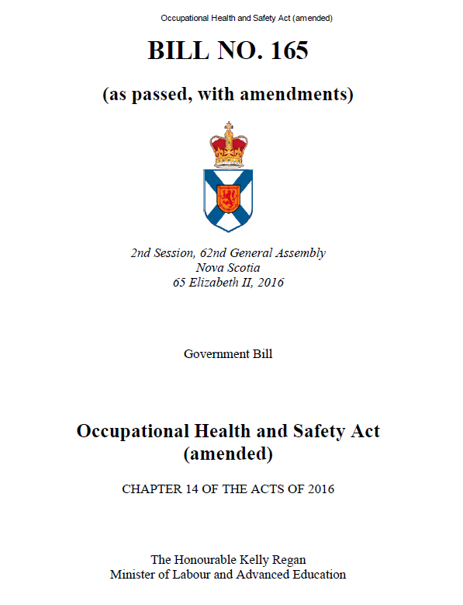
OHS Act Amendments
Amendments to OHS Act passed in Spring 2016 have:
Court Injunction for Repeat Offenders
Power to Order Workplace Information
Stop Work Order Multiple Sites
Reporting Injuries and Incidents (definitions and times)
Amendments come into affect June 12, 2017

Slide 3
Court Injunction
Injunction can only be issued by Nova Scotia Supreme Court
Potential candidate is identified based upon history of fatalities and/or serious injuries and evidence of repeat violations
Case is reviewed with OHS Director
Legal review is conducted
Legal process initiated in some cases
Outcome: If verdict is guilty, individual is ordered by court to stop working in particular field or sector for a set period of time with conditions

Slide 4
Order for Workplace Information
Order issued by OHS Director not Officer
Reasonable grounds to ask for notification
Repeated non-compliance with evidence of incidents or potential for serious injury or fatality
No demonstrated interest to be compliant
The Order can be issued for maximum of three months
The Order would require the violator to provide worksite location information in order to allow an inspection to occur
Outcome: achieve sustained compliance

Slide 5
Stop Work Orders (SWO)- Multiple Sites
Issued by Officer with approval of Director
Rationale: Issue with potential for serious injury or fatality that may exist in other similar workplaces of the employer
Repeated non-compliance, such as not adhering to SWO
Inspect other site if at all possible
Information provided to Director for approval
Outcome: a situation where serious injury or fatality could occur is stopped until compliance confirmed

Slide 6
Serious Injury
Definition changes:
Serious injury – injury that endangers life or causes permanent injury
List what is meant by serious injury
Reporting times
Align with new definitions for timing of report (fatality- immediately; serious injury-asap not exceeding 24 hrs)
More ways to report (email, mail or phone)
Outcome: less non-compliance for reporting; better information on workplace incidents; more effective use of resources to respond in a timely fashion

Slide 7
Serious Injury - Examples
Unconsciousness
Fracture of the skull, spine, pelvis, arm, leg, ankle, wrist or a major part of the hand or foot
Loss or amputation of a leg, arm, hand, foot, finger, or toe
Third-degree burn
Loss of sight in one or both eyes
Asphyxiation or poisoning
Any injury that requires admission to hospital
Any injury that endangers life

Slide 8
Serious Incidents That require notification ASAP, and no later than 24 hours
An accidental explosion
A major structural failure or collapse of a building or other structure
A major release of a hazardous substance
A fall from a work area where fall protection is required by the regulations

Slide 9
A copy of Bill 165 can be found at http://nslegislature.ca/legc/bills/62nd_2nd/3rd_read/b165.htm
For information, contact:
Nova Scotia Labour and Advanced Education
Safety Branch, OHS Division
1-800-9-LABOUR / 902-424-5400
or ohsdivision@novscotia.ca

